Slide 1
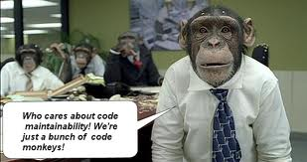
Unit Testing
Tips and Tricks from Lessons Learned

Slide 2
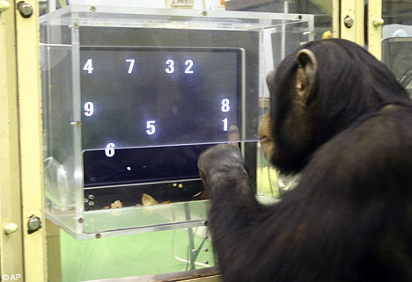
Tools Used
Visual Studio 2008/2010
SQL Server 2005/2008
C# Resharper 5.0
MSUnit (Private Accessor Objects Only)
NUnit
Rhino Mocks
Structure Map AutoMocker
Castle Windsor
Team City
PowerShell
Coded UI
WatiN
TestDriven.NET
Soap UI/Load UI

Slide 3
Unit Testing Negative Mindset
Why should I write unit tests? I can debug my code.
I don’t want to write twice as much code to do something that simple.
Now, I have to maintain to sets of code.
My code works, no reason to test it.
There is not enough time to write tests, the projects plan does not allow for it.
The PM will not see the benefit to take anymore time that is necessary.
Works on my machine.
Hell, the testers will find the bugs.
And so on....

Slide 4

Unit Testing Positive Mindset
I can catch issues before sending the code to the testers.
I can test my code in isolation and force expected results from external devices.
I can ensure new features do not change the existing behaviour unless specified.
I can reproduce defects and verify the defect is corrected prior to release.
Unit testing will reduce the amount of time during testing phases.
Unit testing should be part of the development estimates to allow for proper development.
And so on....

Slide 5
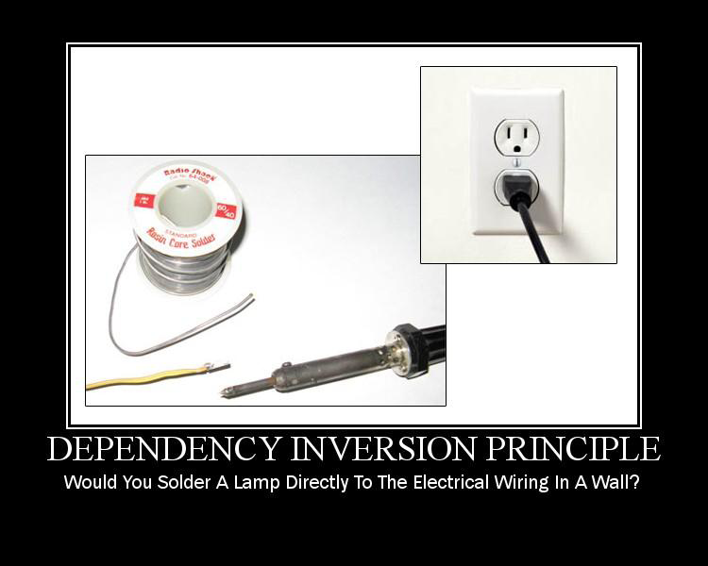
Writing Testable Code
As you write ask yourself how will I test this?
Single Responsibility Principle - Every object should have a single responsibility, and that responsibility should be entirely encapsulated by the class. All its services should be narrowly aligned with that responsibility.
Separate code into Service Methods.
Tie service methods together with Orchestration methods.
Encapsulate behaviour – complex object graphs
Car.Wheel.Tyre.Pressure = newPressure;
- you are introducing coupling.
Also – how do you test this ?
Agile projects – incomplete or unspecified dependant features ? How to test ?

Slide 6

Testing Legacy Code
Issues
Tightly coupled & dependant.
Poorly composed classes/methods
DI ?
Poor Man’s DI
Move to MVC/MVP. Whether you choose passive view or Supervising controller it doesn’t matter just remove the controlling logic.
In my experience don't refactor – rebuild into smaller controls.

Slide 7
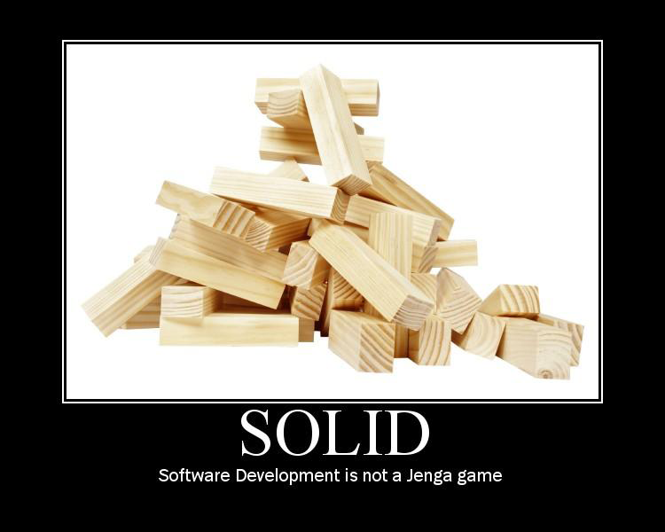
Recognising Time constraints
Technical Debt
We can build it within your crippling time constraints, BUT ....
Post go-live we need to address quality issues and this is how much effort that will take ...
Learn to push back on PMs – the Tech lead is responsible for the quality of the system. If you have quality concerns, raise them and get them addressed formally.
Too much Technical Debt leads to bankruptcy
When you encounter any blocks on the project, go back and write tests.
Make sure you write testable code
Embrace layering, embrace component based coding techniques , interface the be-jesus out of your code.
Write your code for the next developer.

Slide 8

Where to Start?
Test all contracts and entities that will be passed through the application layers.
Test all data adaptors or providers.
Then test workflow and layer communication.
Test integration.
Finally, test the UI.
Three Levels of Testing
UNIT TEST
INTEGRATION TEST
UI TEST

Slide 9

Unit Testing Rules
Write testable code.
Use Inversion of Control as much as possible. For Greenfields projects this is a must!!
Minimise the responsibilities of classes and functions.
Isolate the code to be tested.
Base Classes will be tested in isolation, so classes the inherit from these bases classes do not need to retest the base.
Only test one layer, mock or stub lower layers.
Mock the database calls were possible, but for full coverage the tests should test all the way to the writing and reading of the database.

Slide 10

Unit Testing Rules
Use the AAA pattern - Arrange Act Assert
Create static scenarios so that you can reproduce the same result.
Create a test framework as you go, so you can reuse the logic in other projects.
Understand the limitations of your test tools and you test framework to identify were manual testing will be required.
Write tests that are thorough and easy to understand, so other developers can recognise the pattern used.
Try to create tests that will not require updates every time you refactor your code.
Write generic tests so they can be reused.

Slide 11

Testing Properties
Test Default value upon instantiation
Test setting minimum value.
Test setting maximum value.
Test setting back to default value.
Test interface
[Test]
[Category("version1.0")]
public void TestId()
{
var target = CreateTargetObject();
Assert.IsNotNull(target.Id);
CheckProperty(p => p.Id, int.MinValue, 0, int.MaxValue);
}
[Test]
[Category("version1.0")]
public void TestInterfaceId()
{
var target = CreateTargetInterfaceObject();
Assert.IsNotNull(target.Id);
target.Id = UnitTestValues.Id;
Assert.AreEqual(UnitTestValues.Id, target.Id);
}

Slide 12

Testing Functions
Test actual go path.
Test null parameters for each input parameter.
Test invalid parameters for each input parameters.
Test calling layer with good mocks.
Test calling layer with bad mocks.
Test calling layer with exception mocks.
[Test]
[ExpectedException(typeof(InvalidOperationException))]
public void TestFetchEmptyConnection()
{
var target = CreateTargetObject();
var actual = target.Fetch(new SqlConnection(), 1);
Assert.IsNotNull(actual);
}
[Test]
[Category("version1.0")]
public void TestFetchNullConnection()
{
var target = CreateTargetObject();
var actual = target.Fetch(null, 1);
Assert.IsNotNull(actual);
}
[Test]
[Category("version1.0")]
public void TestFetch()
{
using (var connection = new
DatabaseConnectionProvider().GetConnection())
{
var target = CreateTargetObject();
var actual = target.Fetch(connection,1);
Assert.IsNotNull(actual);
}
}

Slide 13
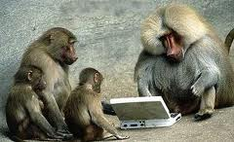
Privates Accessors
public class PrivateAccessor
{
private const string FileName = "BookCatalogService";
private const string FullClassName = "BookCatalogService.Data.FetchBookProvider";
private readonly MSPrivateObject _mmsPrivateObject;
private static readonly MSPrivateType MmsPrivateType = new MSPrivateType(FileName, FullClassName);
public PrivateAccessor(object target)
{
_mmsPrivateObject = new MSPrivateObject(target, MmsPrivateType);
}
public MSPrivateObject MmsPrivateObject
{
get { return _mmsPrivateObject; }
}
public static object CreatePrivate(ISqlResourceLoader sqlResourceLoader)
{
var args = new object[] { sqlResourceLoader };
var privObj = new MSPrivateObject(FileName, FullClassName,
new[] { typeof(ISqlResourceLoader) }, args);
return privObj.Target;
}
public static IBookDetail CreateEntity(IDataReader reader)
{
var args = new object[] { reader };
return ((IBookDetail)(MmsPrivateType.InvokeStatic
("CreateEntity", new[] { typeof(IDataReader) }, args)));
}
}

Slide 14

Testing Privates
Privates should be tested the same way as Public functions or properties
public void TestCreateEntity()
{
var mockReader = MockHelper.CreateBookReaderMock();
var actual = PrivateAccessor.CreateEntity(mockReader);
Assert.IsNotNull(actual);
Assert.IsTrue(actual.Id == 1);
Assert.IsTrue(actual.Title == UnitTestValues.Title);
Assert.IsTrue(actual.Author.FirstName == UnitTestValues.FirstName1);
Assert.IsTrue(actual.Author.LastName == UnitTestValues.LastName1);
}
Privates can be tested by using Reflection, try not to decrease the protection levels. At a last resort change protection level, to add tests.

Slide 15
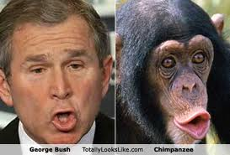
Mock Everything
You should mock or stub everything in the solution, even if not immediately needed. This will help in testing scenarios, and help remove the layers being called.
public static IFetchBookProvider GetFetchBookProviderMock()
{
var mock = MockRepository.GenerateStub<IFetchBookProvider>();
mock.Stub(x => x.Fetch(Arg<SqlConnection>.Is.Anything, Arg<int>.Is.Anything))
.Return(GetBookDetailGoodMock());
return mock;
}
public static IDataReader CreateBookReaderMock()
{
var mock = MockRepository.GenerateMock<IDataReader>();
mock.Expect(x => x.GetOrdinal("Id")).Return(1);
mock.Expect(x => x.GetOrdinal("Title")).Return(2);
mock.Expect(x => x.GetOrdinal("FirstName")).Return(3);
mock.Expect(x => x.GetOrdinal("LastName")).Return(4);
mock.Expect(x => x.GetInt32(1)).Return(1);
mock.Expect(x => x.GetString(2)).Return(UnitTestValues.Title);
mock.Expect(x => x.GetString(3)).Return(UnitTestValues.FirstName1);
mock.Expect(x => x.GetString(4)).Return(UnitTestValues.LastName1);
mock.Stub(x => x.Read()).Return(true).Repeat.Times(1);
mock.Stub(x => x.Read()).Return(false);
return mock;
}

Slide 16

Lessons Learned
MSTest = FAIL
Build Framework to help reduce the time to write tests.
Create class, interface and mocks into one test class to keep everything in one place.
Refactor tests as well as code to reduce the time in writing them
Although you can mock the world, you still need to test the actual objects.
Separate tests into Unit Tests, Integration Tests and UI Tests.
Test Categories – Build Server categories.
ReSharper does not like inheritence, and will only see non-inherited Tests.
WatiN works, needs a framework, and IE needs some work.
Coded UI works, but is hard to extend will need a framework.
SoapUI is a must have for testing services.

